Slide 1


Bipartisan Infrastructure Law and
the Clean Water and Drinking Water
State Revolving Funds
.
Office of Water
www.uswateralliance.org

Slide 2
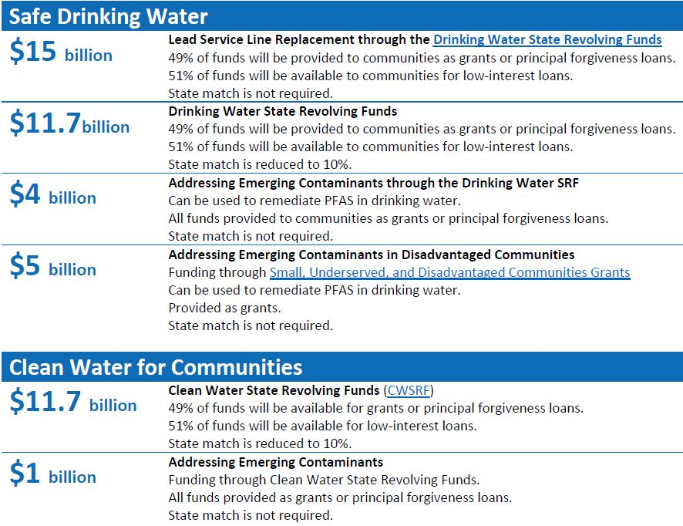
Bipartisan Infrastructure Law (BIL)
Signed by President Biden on November 15, 2021.
Includes $50 billion to the EPA to strengthen the nation’s drinking water and wastewater systems.
Approximately $43.4B of this funding through the existing State Revolving Fund Programs.
Office of Water
2

Slide 3
State Revolving Funds: Overview
What are the SRFs?
  The Clean Water State Revolving Fund (CWSRF) and Drinking Water State Revolving Fund (DWSRF) are federal-state programs that provide funding and financing for a wide range of infrastructure projects.
What are the Purpose of the SRFs?
  To provide government assistance that is intended to reduce the cost of critical public health and environmental infrastructure.
Office of Water
3

Slide 4
CWSRF Funding in the BIL: Overview
EPA is making $12,713,000,000 in additional capitalization grants available to the state CWSRFs over the next five years.
Most of this money may fund any project eligible under the CWSRF; some funding is targeted towards projects focused on “emerging contaminants.”
States have the authority to waive repayment on some of this new funding (e.g., forgive some or all of the loan’s principal or provide grants).
BIL created a new eligible use of the CWSRF – a 2% technical assistance Reserve.

Slide 5
DWSRF Funding in the BIL: Overview
EPA is making $30,713,000,000 in additional capitalization grants (i.e., seed funding) available to the state DWSRFs over the next five years.
Some of this money may fund any project eligible under the DWSRF; some funding is targeted towards projects focused on PFAS and “emerging contaminants;” some funding is targeted towards the identification and replacement of lead service lines.
States have the authority to waive repayment on some of this new funding (e.g., forgive some or all of the loan’s principal or provide grants).
Notes:
In addition to the SRF funding, EPA is distributing earmark grants from the FY 2022 appropriations to the Agency. These are direct grants of money for infrastructure projects.
Region 2’s first earmark grant from the FY 2022 appropriation was just awarded to the Village of Ridgewood in the amount of $2,800,000. The grant will fund the construction of a new drinking water treatment facility for the removal of Per- and Polyfluoroalkyl substances (PFAS). To date, we have received 10 applications.

Slide 6
SRF and BIL Information
CWSRF: https://www.epa.gov/cwsrf
  State CWSRF contacts
DWSRF: https://www.epa.gov/dwsrf
  State DWSRF contacts
BIL: https://www.epa.gov/infrastructure
EPA Region 2: Christine Ash, ash.christine@epa.gov
Office of Water
6

